Slide 1
Credit card fraud detection using machine learning

Slide 2

Business problem
Challenge: Credit card fraud costs financial institutions billions each year.
Impact: Financial loss, decreased customer trust, operational inefficiencies.
Goal: Detect and prevent fraudulent transactions in real time.

Slide 3

Dataset overview
Credit card Fraud Detection collected from Kaggle

Slide 4
DATASET OVERVIEW
Source: Kaggle Credit Card Fraud Dataset
Size: 284,807 transactions
Fraudulent Transactions: 492 (0.172%)
Features: 28 anonymized PCA features + Amount & Time

Slide 5

DATA Preparation
Dropped the 'Time' feature
Scaled the 'Amount' feature using StandardScaler
Addressed class imbalance using stratified sampling and class weights

Slide 6
Exploratory Data Analysis
Highly imbalanced dataset
Most features have minimal correlation
Used heatmaps and class distribution plots for insights

Slide 7

Model selection
Decision Tree: Simple, interpretable, handles class imbalance well
Random Forest: Ensemble model, higher accuracy, robustness
Logistic Regression: Fast and efficient for large datasets

Slide 8
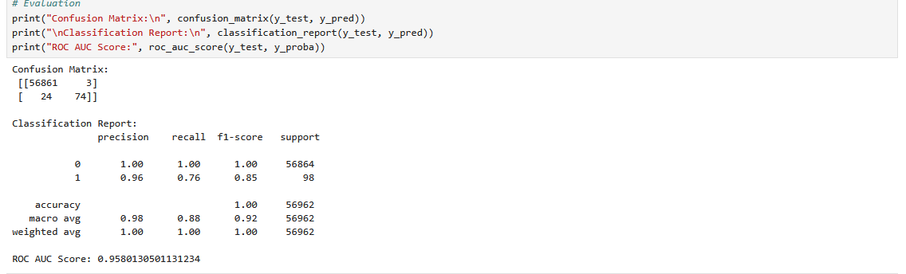
Model training & Evalution

Slide 9
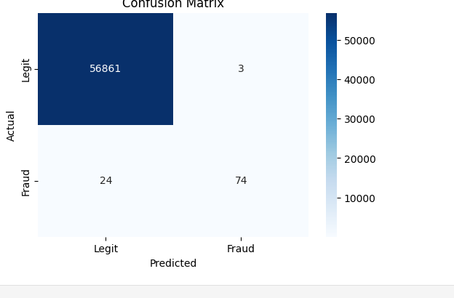
Confusion matrix visualization

Slide 11
Clustering & dimensionality reduction
The dataset already includes PCA-transformed features (V1 to V28)
Additional dimensionality reduction was not necessary
Focus remained on supervised learning models (Decision Tree , Logistic Regression & Random Forest)

Slide 12
Business impact
Prevents major fraud losses
Reduces manual investigation workload
Enhances customer trust

Slide 13

recommendation
Deploy model into real-time transaction monitoring systems
Retrain with updated data regularly
Use customer feedback to improve model accuracy

Slide 14
conclusion
ML models effectively detect fraud
High accuracy with minimal false positives
Strong business case for deployment and ROI

